Slide 1


ZYNQ-Disease Detect: Precision Agriculture Solutions and Comparative Studies with AI Technologies
Mid-Review 1/2/3
Major Project
Project ID: PROJ3999
AY 2021-25
GITAM (Deemed-to-be) University
Department of Electrical Electronics and Communication Engineering
Project Team:
BU21EECE0100100 (S.Sameera Tasneem)
BU21EECE0100103 (S.Sai Lohitha)
BU21EECE0100360 (R.Indumathi)
Project Mentor:
Dr. M. Arun Kumar
Associate Professor
Project In-charge:
Dr. M. Arun Kumar
www.gitam.edu

Slide 2
Objective and Goals
Objective
Brief Description
To use ZYNQ 7000 SoC to process plant leaf images and videos, focusing on edge detection and real-time analysis.
To develop external AI models to classify plant diseases based on processed data.
To ensure real-time performance and robustness under varying agricultural conditions.
To compare ZYNQ’s image processing performance with other platforms.
Goals
Main Goals
Real-Time Disease Detection:
Achieve accurate and timely detection of plant diseases to facilitate prompt intervention.
Scalable Agricultural Solution:
Develop a cost-effective and scalable system suitable for deployment in diverse agricultural environments.
Additional Goals
Expand detection to other agricultural diagnostics like pests or nutrient deficiencies.
Validate the system through field tests for practical usability and refinement.
Develop a user-friendly interface to assist farmers in decision-making.

Slide 3
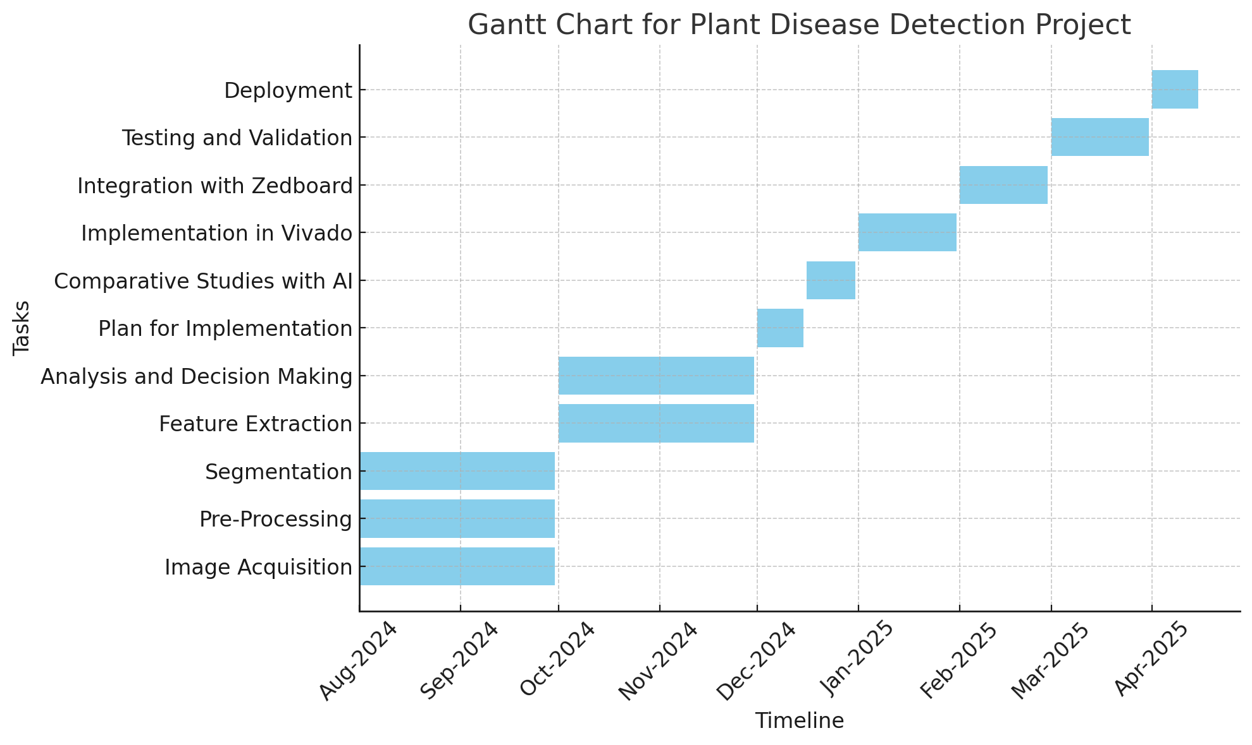
Project Plan (Clearly mention milestone for objectives under each reviews)
Gant Chart - Milestones and Activities
Resources : https://www.officetimeline.com/gantt-chart/how-to-make/excel & https://www.teamgantt.com/
Phase-2
Review 1
Phase-1
Figure: Gantt Chart for FPGA-Based Plant Disease Detection System Development

Slide 4
Milestones
Literature Survey & Objective Finalization
Completed literature review and finalized project objectives.
MATLAB Implementation
Implemented Canny and Sobel edge detection.
Used Otsu’s method and K-means clustering for separating healthy and diseased plant parts.
Vivado Setup for ZYNQ 7000 SoC
Transition to Vivado for hardware integration with ZYNQ 7000 SoC.
Interface image/video processing with the SoC.
Real-Time Processing on ZYNQ 7000
Implement image processing techniques on ZYNQ 7000 SoC for real-time disease detection.
AI Model Development
Develop and integrate AI models (e.g., CNNs) for plant disease classification.
System Testing & Validation
Test and validate the system in real-world agricultural settings.
Comparative Study
Compare AI-based methods with traditional image processing techniques.
Optimization & Scalability
Optimize system performance and explore scalability for larger fields.
Documentation & Future Work
Document findings and plan future enhancements for the system.

Slide 5
Literature Survey (Improved post minor project)
Key Publications
Google scholar research best 3-5 papers
V. K. Perumal, T. Supriyaa, S. P. R., and S. Dhanasekaran, "CNN based plant disease identification using PYNQ FPGA," in Systems and Soft Computing, vol. 6, p. 200088, 2024. doi: https://doi.org/10.1016/j.sasc.2024.200088.
B. Sasmal, A. Das, K. G. Dhal, S. B. Saheb, R. A. Khurma, and P. A. Castillo, "A novel groundnut leaf dataset for detection and classification of groundnut leaf diseases," in Data in Brief, vol. 55, p. 110763, 2024. doi: https://doi.org/10.1016/j.dib.2024.110763.
J. Ahmed, S. A. A. Zaidi, S. Aziz, A. Rashid, and S. Haider, "Real time vision-based implementation of plant disease identification system on FPGA," in Mehran University Research Journal of Engineering and Technology, vol. 42, no. 2, pp. 19-29, 2023. doi: 10.22581/muet1982.2302.03.
Key Resources – Whitepaper| Application Notes | Datasheet| Others
CNN-based Plant Disease Identification using PYNQ FPGA
Key Resources:
Whitepapers:
Implementation of Convolutional Neural Networks (CNN) on FPGA platforms.
Overview of the PYNQ FPGA ecosystem for AI applications.
Application Notes:
Deploying TensorFlow or PyTorch models on PYNQ FPGA.
PYNQ-Z2 board application note for AI/ML applications.

Slide 6
Datasheets:
Technical datasheet for PYNQ-Z2 board detailing hardware specs.
FPGA acceleration datasheet for CNN-based inference.
Other Resources:
Python and Jupyter Notebook examples for plant disease datasets.
Open-source repositories for CNN-based plant disease detection.
A Novel Groundnut Leaf Dataset for Detection and Classification of Groundnut Leaf Diseases
Key Resources:
Datasets:
Groundnut leaf image dataset, including labeled images for classification.
Augmentation tools or scripts used to preprocess the dataset.
Whitepapers:
Creating robust datasets for agricultural disease detection.
Statistical methods to ensure dataset diversity and quality.
Others:
Metadata on dataset: resolution, size, categories, etc.
Documentation on dataset collection methodology.
Real-Time Vision-Based Implementation of Plant Disease Identification System on FPGA
Key Resources:
Whitepapers:
Real-time systems for agricultural applications using FPGA.
Vision-based disease detection techniques for plants.
Application Notes:
FPGA-based image processing pipeline for real-time inference.
Guidelines for implementing Sobel/Canny edge detection on FPGA.

Slide 7
Datasheets:
Details on the specific FPGA board (e.g., Zynq 7000 SoC).
Other Resources:
Edge AI frameworks (e.g., Vitis AI, Xilinx tools).
Case studies on agricultural IoT systems integrated with FPGA
Existing Implementations – Products| Opensource| GitHub etc
Products:
Plantix App: AI-powered plant disease detection and remedies. Visit: www.plantix.net
Leaf Doctor: Tool for analyzing leaf damage in crops.
Open-Source Tools:
PlantVillage Dataset: Comprehensive dataset of diseased and healthy plant leaves. Access: www.plantvillage.org
OpenCV: Library for image preprocessing and edge detection. Visit: opencv.org
TensorFlow/PyTorch: Frameworks for CNN model training and deployment.
TensorFlow: www.tensorflow.org
PyTorch: pytorch.org
GitHub Repositories:
PYNQ-ML: Deploying ML models on PYNQ FPGA. Repo: www.github.com/Xilinx/PYNQ-ML
CNN for Plant Disease: Implementation using PlantVillage dataset. Repo: www.github.com/spMohanty/PlantVillage-Dataset
FPGA Image Processing: Real-time classification projects on FPGA. Repo: www.github.com/Xilinx/Embedded-Design-Tutorials

Slide 8
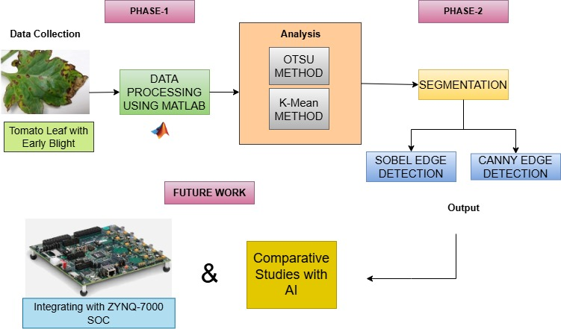
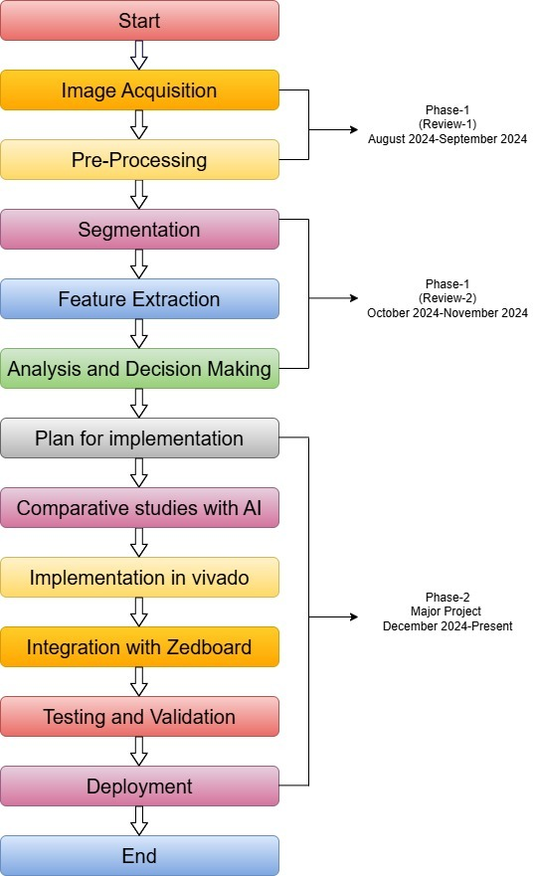
Architecture
Structural Diagram
Block Diagram/Pin Diagram
Fig a. Circuit Implementation of the proposed system
Behaviour Diagram
Flow chart/ State machine
Fig b. WorkPlan of the proposed system

Slide 9
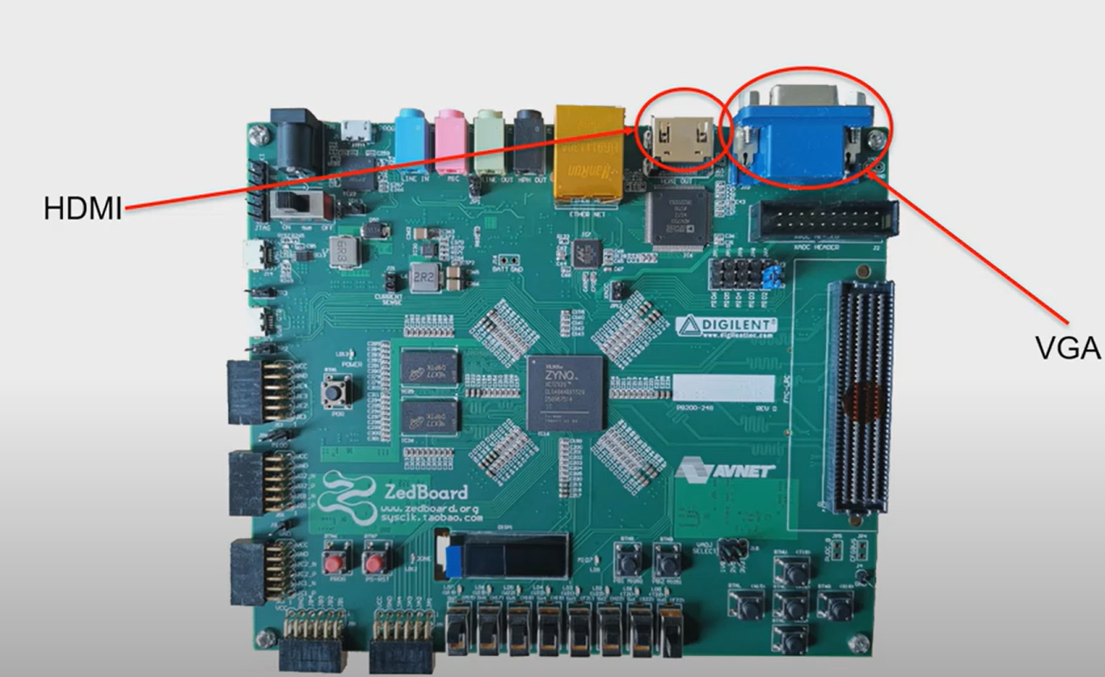
ZedBoard vs Nexys 4: Performance and Display Interface Overview
ZedBoard has an ARM Cortex-A9 processor that handles complex tasks like edge detection, while Nexys 4 relies only on hardware, making it less flexible.
The ZedBoard combines software and FPGA for efficient processing, whereas Nexys 4 is limited to hardware-only implementations, making development harder.
ZedBoard supports tools like Linux and OpenCV, making video and image processing faster and easier compared to Nexys 4.
ZedBoard’s architecture handles high-resolution images and real-time video better, while Nexys 4 may struggle with resource-intensive tasks.
ZedBoard Display Interfaces:
VGA Controller:
A VGA (Video Graphics Array) Controller is a component that generates the necessary timing and signals to interface with a VGA display.
It creates synchronization signals (horizontal sync and vertical sync) and manages the pixel data for rendering images on a VGA monitor.
HDMI:
HDMI (High-Definition Multimedia Interface) is a digital connection used to transmit high-quality video and audio signals between devices, like TVs, monitors, and laptops.
Fig-ZYNQ 7000 SOC Board

Slide 10
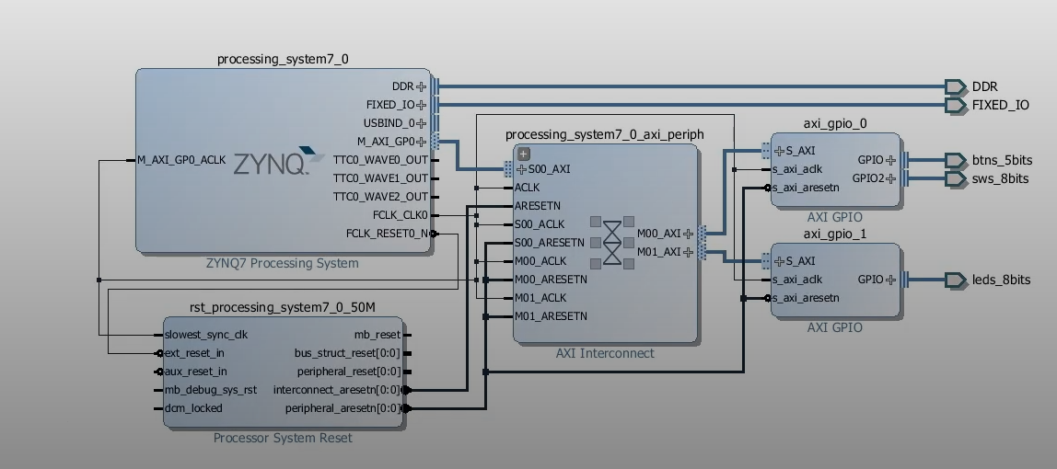
Steps to Design and Implement a Zynq-Based VGA Controller in Vivado
The process of creating a block diagram for a Zynq-based VGA Controller starts with visualizing the key components of the system and their interactions.
Create Vivado Project: Start a new RTL Project and select the FPGA part.
Add Zynq Processing System IP: Use Zynq PS for processing, configure clocks, reset, and peripherals.
Add VGA Controller IP: Add VGA sync and pixel generator IPs (or custom logic for VGA signals).
Configure Clock and Reset: Add Clocking Wizard for VGA pixel clock and Reset Generator for initialization.
Create Block Design: Drag and connect Zynq PS, clock, reset, and VGA signals (e.g., vid_hsync ,vid_vsync).
Define Address Map (If Needed): Map peripherals to specific addresses using AXI interface.
Connect I/O Ports: Assign pins for VGA signal(Dout,vid_hsync,vid_vsync) in the I/O Planning view.
Generate Bitstream: Synthesize and generate the bitstream for FPGA.
Simulate (Optional): Simulate design and verify output signals.
Export Design: Export the HDL wrapper and generate the bitstream for hardware implementation.
Fig:Block Diagram of ZYNQ before doing HDL
Wrapper

Slide 11
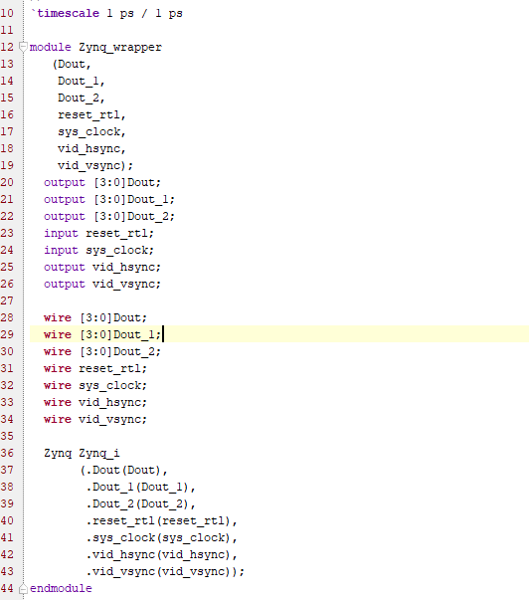
Analysis of the Code
Inputs:
reset_rtl: The reset signal to initialize the system.
sys_clock: The system clock that drives the VGA controller.
Outputs:
Dout, Dout_1, Dout_2: Data outputs (4-bit) that likely represent color or pixel data for the display.
vid_hsync, vid_vsync:Horizontal and vertical synchronization signals for the VGA display.
Module Instantiation:
The Zynq module is instantiated within this wrapper, which takes the inputs(reset_rtl, sys_clock) and drives the outputs(Dout, Dout_1, Dout_2, vid_hsync, vid_vsync).
Fig-Code Generated for the ZYNQ Wrapper Block Diagram

Slide 12
Use Cases & Testing
Use Cases
Generate Pixel Data (Datagen):
Generates pixel data for display using inputs sys_clock and reset_rtl, producing outputs Dout, Dout_1 and Dout_2.
Success is defined by generating correct pixel data based on coordinates.
Generate Sync Signals (Synchronization):
Creates horizontal and vertical sync signals(vid_hsync, vid_vsync) for the VGA display using sys_clock and reset_rtl.
Success ensures correct timing and synchronization for the display.
Multiplex Pixel Data:
Selects and routes appropriate pixel data for display based on control signals, producing outputs Dout, Dout_1, and Dout_2.
Success ensures correct pixel data is routed to the output.
Test Cases
Validate Pixel Data Generation
Objective: Ensure correct pixel data from Dout, Dout_1 and Dout_2.
Steps: Apply sys_clock and reset_rtl, and monitor outputs.
Expected Result: The pixel data corresponds to the expected color pattern.
Validate Sync Signal Generation:
Objective: Verify that vid_hsync and vid_vsync signals are generated correctly.
Steps: Apply sys_clock and reset_rtl, and check the sync signals against the VGA timing specifications.
Expected Result: Horizontal and vertical sync signals follow proper VGA timing.
Test Data Multiplexing:
Objective: Ensure that the multiplexer(mux.v) selects and routes the correct data.
Steps: Apply control signals to select Dout, Dout_1 or Dout_2,and verify the output.
Expected Result: The selected data is correctly routed to the VGA output.
Verify Reset Functionality:
Objective: Ensure that the system resets as expected.
Steps: Apply the reset_rtl signal and verify that the outputs are inactive or reset.
Expected Result: All outputs reset to their initial states.

Slide 13
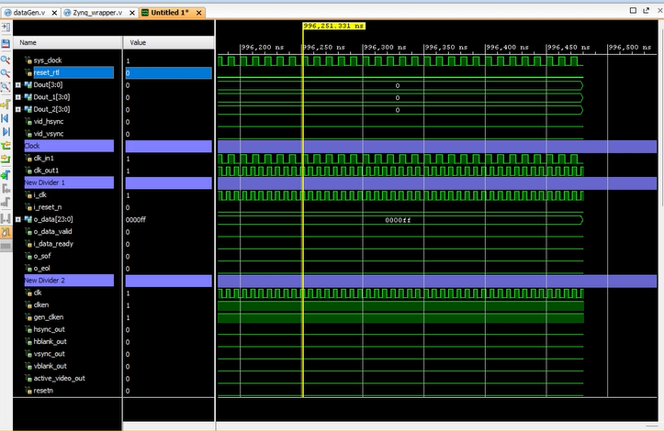
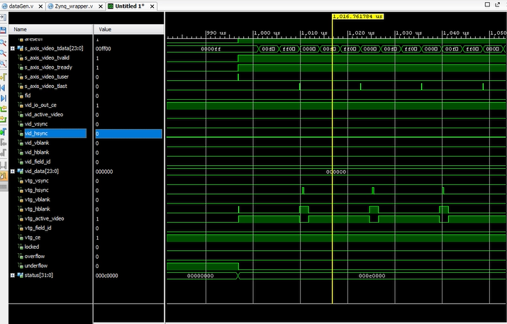
Implementation and Results – Iteration 1
Iteration 1 : Results
Fig-1:RTL Schematic Diagram of ZYNQ for force value 0
Fig-2: RTL Schematic Diagram of ZYNQ for force value 1

Slide 14
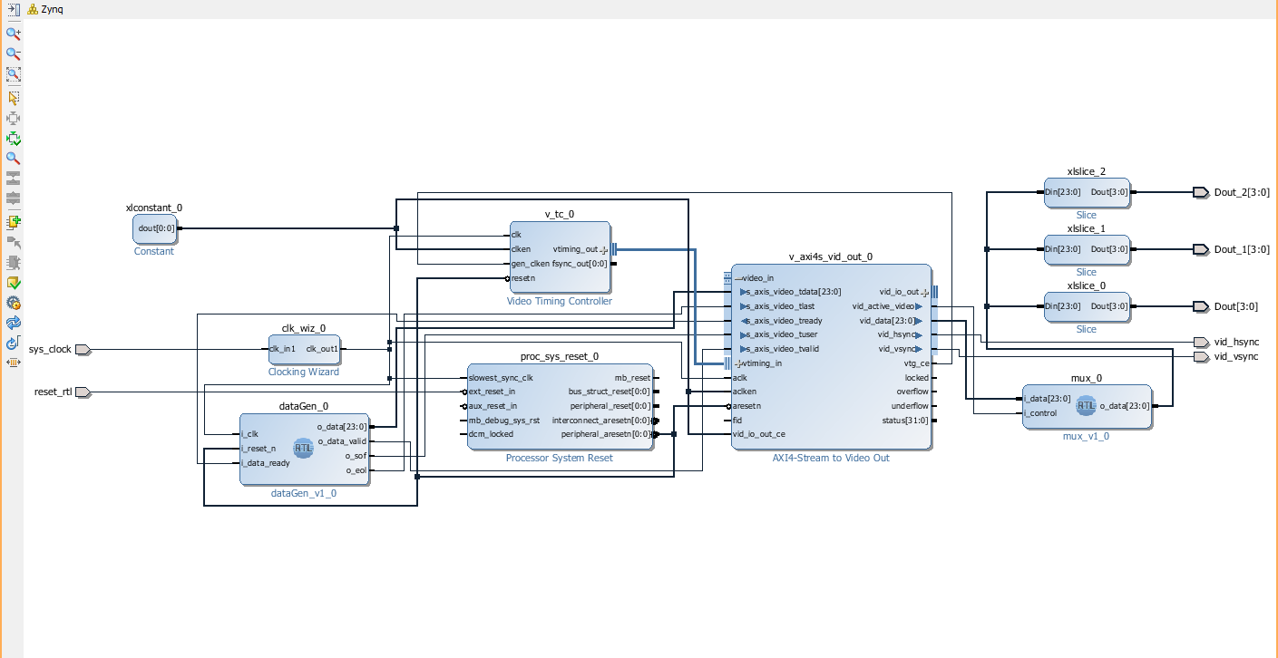
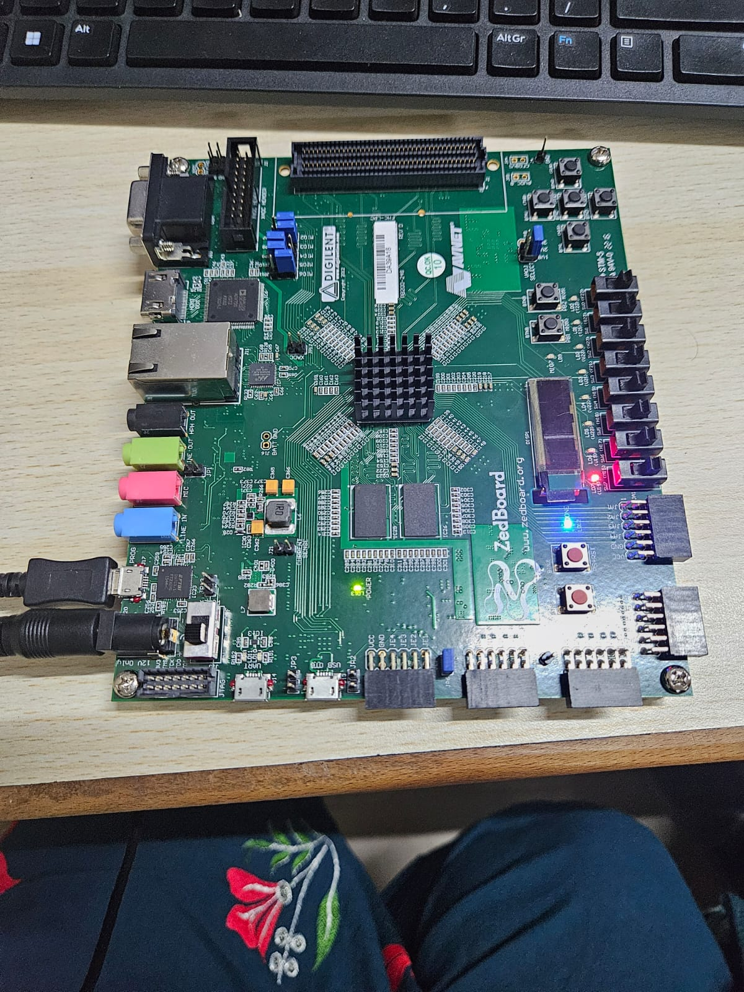
Fig-3:Block Diagram of ZYNQ Wrapper
Fig-4:Interfacing with ZYNQ 7000 SOC

Slide 15
Conclusion & Future Work
Summary and Conclusion
The project focuses on segmenting diseased plant areas using image processing techniques in MATLAB, with methods like Otsu’s thresholding, Canny, and Sobel edge detection to improve disease detection accuracy and efficiency.
Interfacing with the ZYNQ 7000 SoC using Xilinx tools has been initiated, and the MATLAB-based segmentation work has been completed, laying the groundwork for edge AI-based implementation.
By automating the segmentation of diseased plant portions, the system helps in early disease detection, offering valuable support to farmers and agricultural researchers for better crop management.
Future Work
Implement edge detection algorithms (Canny, Sobel) on ZYNQ 7000 SoC for real-time plant disease segmentation.
Begin integration of Edge AI models for classifying diseased plants based on detected features.
Optimize processing efficiency and accuracy for faster, low-latency disease detection on edge devices.
Conduct a comparative study of various edge detection and AI classification techniques for improved plant disease identification.

Slide 16
THANK YOU
Have a Great Day !

Slide 17
Implementation and Results – Iteration 2
Iteration : Results + Validation against the use cases and test cases

Slide 18
Implementation and Results – Iteration 3 (Optional)
Iteration : Results + Validation against the use cases and test cases

Slide 19
Contribution
Team Progress and Movement
Xx
Xx
X
X
Individual Contribution
Key contributions: Team Member Name
XX
XX
Key contributions: Team Member Name
XX
XX
Key contributions: Team Member Name
XX
XX
Key contributions: Team Member Name
XX
XX
Key contributions: Team Member Name
XX
XX

